Slide 1

GANDHI INSTITUTE OF SCIENCE AND TECHNOLOGY KHOLIGUDA RAYAGADA SEMINAR : DATA SCIENCE
M.SATYA SAI CHOUDHURY
B.Tech FINAL YEAR CSE
REGD NO :1901317070

Slide 2
Agenda
What is Data Science?
Why Data Science?
Data science & Components
What is Data Science Process
Discovery of Data Science
Preparation
Model Planning in Data Science
Model in Data Science
Data Science Video
Operationalize in Data Science
Communicate Results in Data Science
Data Science Jobs Roles
Tools for Data Science
Difference Between Data Science with BI (Business Intelligence)
Applications of Data Science
Challenges of Data Science Technology
Vote of Thanks

Slide 3






Slide 4


What is Data Science?
Data Science is the area of study which involves extracting insights from vast amounts of data using various scientific methods, algorithms, and processes. It helps you to discover hidden patterns from the raw data. The term Data Science has emerged because of the evolution of mathematical statistics, data analysis, and big data.
Data Science is an interdisciplinary field that allows you to extract knowledge from structured or unstructured data. Data science enables you to translate a business problem into a research project and then translate it back into a practical solution.

Slide 5

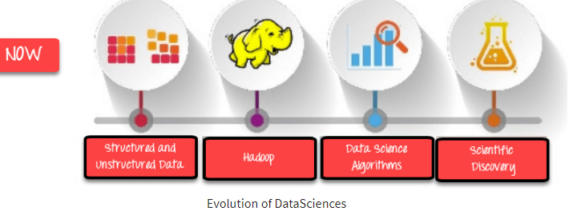
Why Data Science?
Data is the oil for today’s world. With the right tools, technologies, algorithms, we can use data and convert it into a distinct business advantage
Data Science can help you to detect fraud using advanced machine learning algorithms
It helps you to prevent any significant monetary losses
Allow to build intelligence ability in machines
You can perform sentiment analysis to gauge customer brand loyalty
It enables you to take better and faster decisions
It helps you to recommend the right product to the right customer to enhance your business

Slide 6
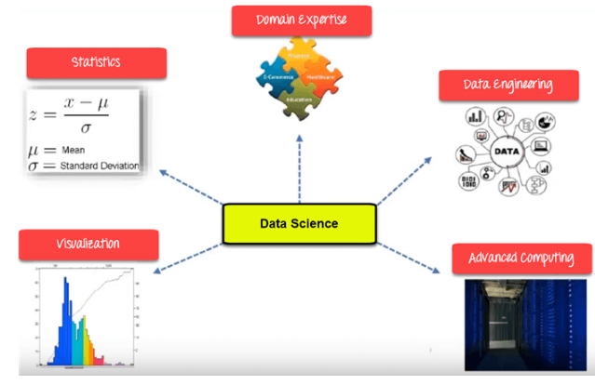
Data Science Components
Statistics
Visualization
Machine Learning
Deep Learning

Slide 7

Statistics
Statistics is the most critical unit of Data Science basics, and it is the method or science of collecting and analyzing numerical data in large quantities to get useful insights.
Statistics is a collection of principles and parameters the helps data scientists gain information about their data to make decisions when faced with uncertainty

Slide 8

Visualization
Visualization technique helps you access huge amounts of data in easy to understand and digestible visuals.
Data visualization is the process of creating interactive visuals to understand trends, variations, and derive meaningful insights from the data. Data visualization is used mainly for data checking and cleaning, exploration and discovery, and communicating results to business stakeholders.

Slide 9

Machine Learning
Machine Learning explores the building and study of algorithms that learn to make predictions about unforeseen/future data.
Machine learning (ML) is a statistical approach to studying and making inferences about data that utilizes a variety of algorithms suited for answering different types of questions. There are three main types of ML: supervised, unsupervised, and reinforcement learning.

Slide 10

Deep Learning
Deep learning defined Deep learning is a subset of machine learning (ML), where artificial neural networks—algorithms modeled to work like the human brain—learn from large amounts of data. How does deep learning work? Deep learning is powered by layers of neural networks, which are algorithms loosely modeled on the way human brains work.
This Photo by Unknown author is licensed under CC BY.

Slide 11
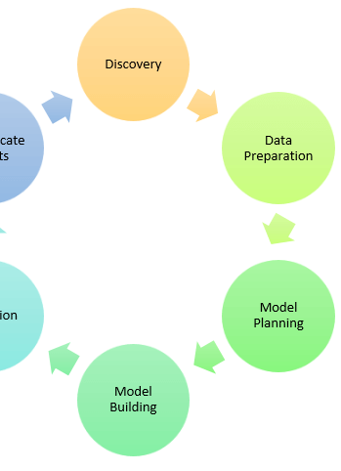
What is Data Science process
Frame the problem
Collect the raw data needed for your problem
Process the data for analysis
Explore the data
Perform in-depth analysis
Communicate results of the analysis

Slide 12

Discovery
Discovery step involves acquiring data from all the identified internal & external sources, which helps you answer the business question.
The data can be
Logs from webservers
Data gathered from social media
Census datasets
Data streamed from online sources using APIs

Slide 13

Preparation
Data can have many inconsistencies like missing values, blank columns, an incorrect data format, which needs to be cleaned. You need to process, explore and condition data before modelling. The cleaner your data, the better are your predictions.
When you’re ready to start data science, the first step is typically data preparation. Data preparation can involve various tasks, from cleaning and organizing your data to transforming it into the format you need.
If you’re starting, it’s important to remember that data preparation isn’t a one-time event. Instead, it’s a continuous process that you should continue throughout your data science journey.

Slide 14

Model Planning in Data Science
Model planning is phase 3 of lifecycle phases of data analytics, where team determines methods, techniques, and workflow it intends to follow for subsequent model building phase.
In this stage, you need to determine the method and technique to draw the relation between input variables. Planning for a model is performed by using different statistical formulas and visualization tools. SQL analysis services, R, and SAS/access are some of the tools used for this purpose.

Slide 15
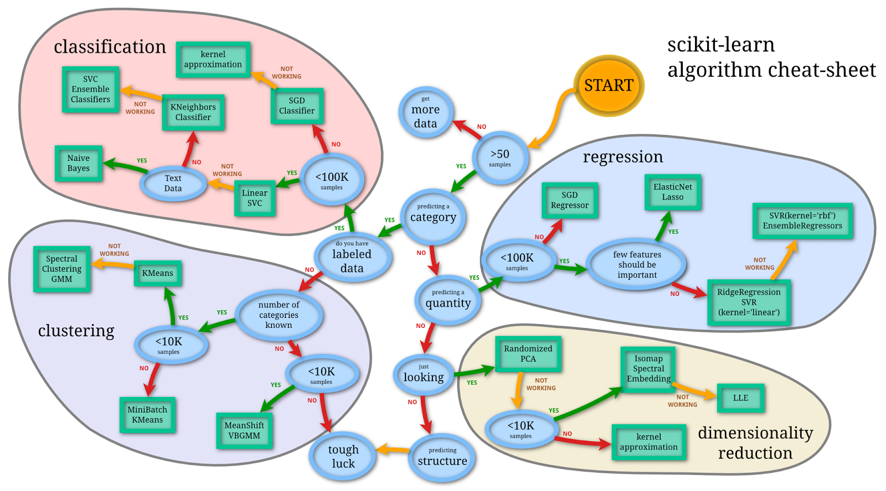
Model Building in Data Science
The model building process involves setting up ways of collecting data, understanding and paying attention to what is important in the data to answer the questions you are asking, finding a statistical, mathematical or a simulation model to gain understanding and make predictions.
The actual model building process starts. Here, Data scientist distributes datasets for training and testing. Techniques like association, classification, and clustering are applied to the training data set. The model, once prepared, is tested against the “testing” dataset.

Slide 16
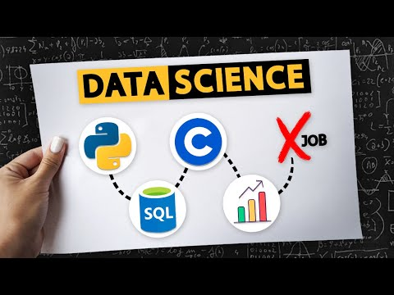

Slide 17
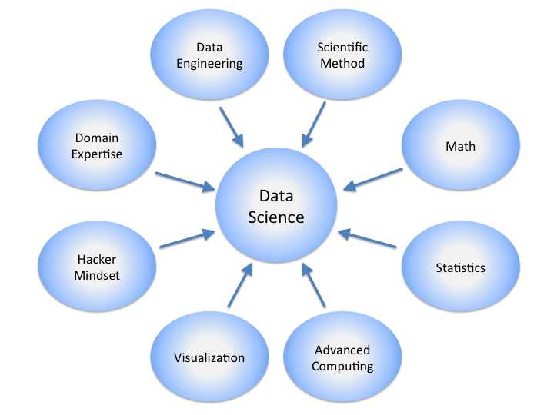
Operationalize in Data Science
The process of operationalizing data science by getting data science models into production and then managing them. The four main steps in the Model Ops process — build, manage, deploy/integrate, and monitor — form a repeatable cycle that you can leverage to reuse your models as software artifacts.
You deliver the final baselined model with reports, code, and technical documents in this stage. Model is deployed into a real-time production environment after thorough testing.

Slide 18

Communicate Results in Data Science
When people stress the importance of good communication in data science, they are usually saying something like what Hadley Wickham says in his book R for Data Science: “[It] doesn’t matter how great your analysis is unless you can explain it to others: you need to communicate your results.”
The key findings are communicated to all stakeholders. This helps you decide if the project results are a success or a failure based on the inputs from the model.

Slide 19
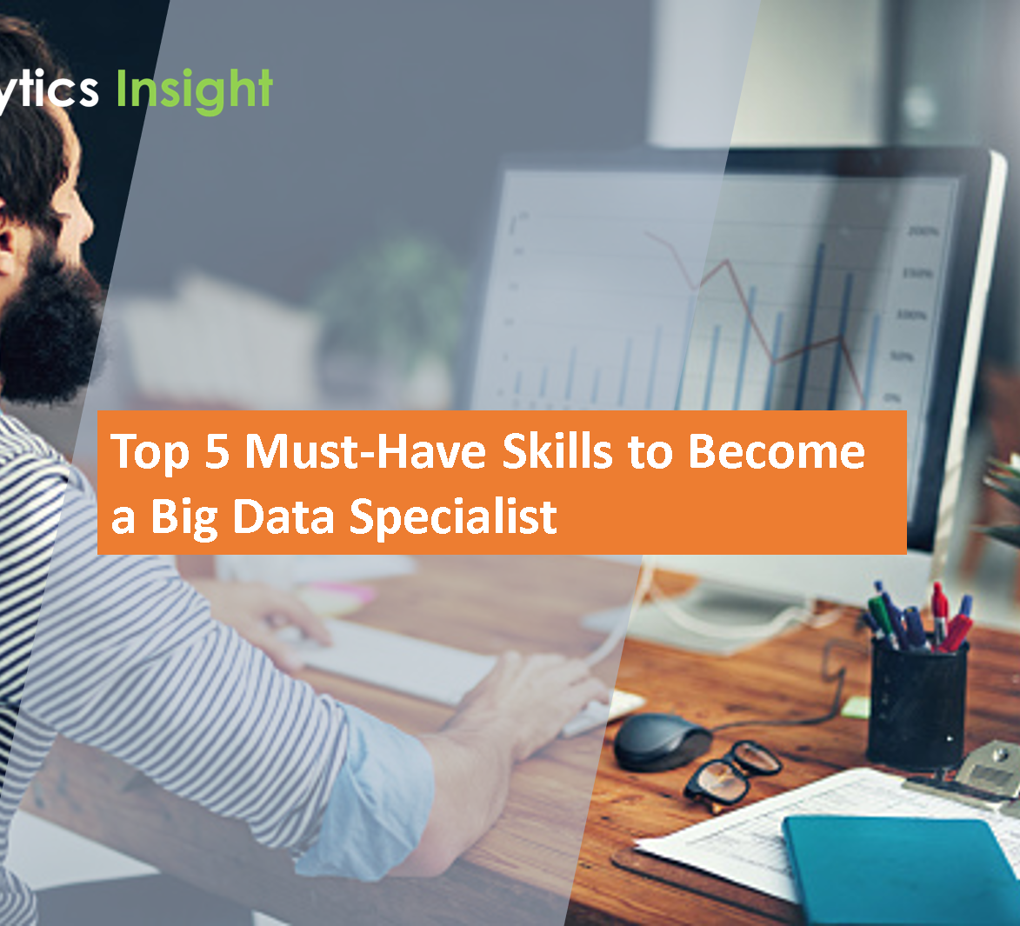
Data Science Jobs Roles
Data Scientist
Data Engineer
Data Analyst
Statistician
Data Architect
Data Admin
Business Analyst
Data/Analytics Manager

Slide 20
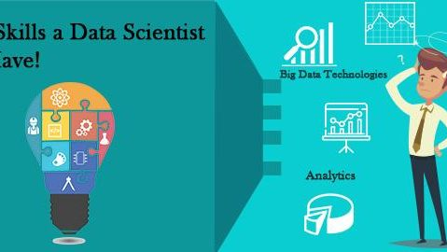
Data Scientist
Data Scientist is a professional who manages enormous amounts of data to come up with compelling business visions by using various tools, techniques, methodologies, algorithms, etc.
Languages: R, SAS, Python, SQL, Hive, Matlab, Pig, Spark

Slide 21

Data Engineer
The role of a data engineer is of working with large amounts of data. He develops, constructs, tests, and maintains architectures like large scale processing systems and databases.
A data engineer is an IT worker whose primary job is to prepare data for analytical or operational uses. These software engineers are typically responsible for building data pipelines to bring together information from different source systems. They integrate, consolidate and cleanse data and structure it for use in analytics applications.
Languages: SQL, Hive, R, SAS, Matlab, Python, Java, Ruby, C + +, and Perl

Slide 22

Data Analyst
A data analyst is responsible for mining vast amounts of data. They will look for relationships, patterns, trends in data. Later he or she will deliver compelling reporting and visualization for analyzing the data to take the most viable business decisions.
A data analyst is a professional who collects and analyzes data in order to turn it into meaningful information that companies can use to improve and grow. These individuals gather information from a number of sources and are skilled in researching, analyzing and reporting.
Languages: R, Python, HTML, JS, C, C+ + , SQL

Slide 23

Statistician
The statistician collects, analyses, and understands qualitative and quantitative data using statistical theories and methods.
Data science includes extracting data and results, and statistics focus on the analysis and communication of the data results. Statistical data science works to explain the trends and results of a data set by identifying the statistical correlations and distribution of variables and values.
Languages: SQL, R, Matlab, Tableau, Python, Perl, Spark, and Hive

Slide 24

Data Administrator
Data admin should ensure that the database is accessible to all relevant users. He also ensures that it is performing correctly and keeps it safe from hacking.
Administrative data is the data that organizations collect about their operations. It includes data for routine operations, and is frequently used to assess how well an organization is achieving its intended goals.
Languages: Ruby on Rails, SQL, Java, C#, and Python

Slide 25

Business Analyst
This professional needs to improve business processes. He/she is an intermediary between the business executive team and the IT department.
Business data is the collective information related to a company and its operations. This can include any statistical information, raw analytical data, customer feedback data, sales numbers and other sets of information.
Languages: SQL, Tableau, Power BI and, Python

Slide 26
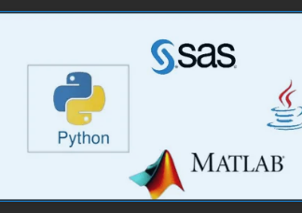
Tools for Data Science
Apache Hadoop
SAS (Statistical Analysis System)
Apache Spark
Data Robot
Tableau

Slide 27
Difference Between Data Science with BI (Business Intelligence)
Parameters | Business Intelligence | Data Science
Perception | Looking Backward | Looking Forward
Data Sources | Structured Data. Mostly SQL, but some time Data Warehouse) | Structured and Unstructured data. Like logs, SQL, NoSQL, or text
Approach | Statistics & Visualization | Statistics, Machine Learning, and Graph
Emphasis | Past & Present | Analysis & Neuro-linguistic Programming
Tools | Pentaho. Microsoft Bl, QlikView, | R, TensorFlow

Slide 28

Applications of Data Science
Internet : Search Google search uses Data science technology to search for a specific result within a fraction of a second
Recommendation Systems :To create a recommendation system. For example, “suggested friends” on Facebook or suggested videos” on YouTube, everything is done with the help of Data Science.
Image & Speech Recognition: Speech recognizes systems like Siri, Google Assistant, and Alexa run on the Data science technique. Moreover, Facebook recognizes your friend when you upload a photo with them, with the help of Data Science.
Gaming World: EA Sports, Sony, Nintendo are using Data science technology. This enhances your gaming experience. Games are now developed using Machine Learning techniques, and they can update themselves when you move to higher levels.
Online Price Comparison: PriceRunner, Junglee, Shopzilla work on the Data science mechanism. Here, data is fetched from the relevant websites using APIs.

Slide 29

Challenges of Data Science Technology
A high variety of information & data is required for accurate analysis
Not adequate data science talent pool available
Management does not provide financial support for a data science team
Unavailability of/difficult access to data
Business decision-makers do not effectively use data Science results
Explaining data science to others is difficult
Privacy issues
Lack of significant domain expert
If an organization is very small, it can’t have a Data Science team

Slide 30


